Slide 1
ARV Side Effects, Adverse Drug Reactions (ADRs) and Management

Slide 2
Unit Specific Objectives
At the end of this unit the participants will be able to:
Define Adverse drug reactions and other related terms
Discuss predisposing factors to ADRs
Explain how to recognize and prevent ADRs in daily practice
State how to manage the common side effects and ADRs of ARVs.
Notes:
Trainers Notes:
Use this slide to introduce the unit objective

Slide 3
Brain Storming Session
(5 mins)
Can you define:
What is a side effect?
What is an adverse event?
What is an adverse drug reaction?
Notes:
Trainer Notes:
Spend about 10 minutes brainstorming on these definitions.
Ask the participants to try and define the terms and to differentiate them.
(May ask them to discuss in groups)

Slide 4
Side Effect (SE)
Any unintended effect of a pharmaceutical product occurring at doses normally used in humans, which is related to the pharmacological properties of the medicine.
Notes:
Trainer Notes:
Use this slide to define a side effect.
A side effect of a medicine is any unintended consequence (whether harmful or beneficial) following administration of the medicine.
Highlight the key points: unintended effect, normal doses, and especially related to pharmacological properties of the medicine.
Explain that this is an old WHO definition. SE is broad enough to include both positive and negative effects of a medicine apart from its main properties or indications.
Example of positive effects:
The vasodilator Minoxidil causing hair growth.
Sildenafil Citrate was first tested for the treatment of Angina and hypertension. It was shown to have little effect on Angina but could induce erectile erection. The manufacturer decided to market it for the treatment of erectile dysfunction.

Slide 5
Examples of SE
What are the common side effects and
adverse drugs reactions observed in your
facility by:
      Patients
      Clinicians?
Notes:
Trainer Notes:
Ask the participants to answer this question. Probe for examples

Slide 6
Common Side Effects
  Nausea
  Vomiting
  Diarrhoea
  Constipation
  Lethargy, fatigue
Headaches
Dizziness
Flu-like symptoms
Mild rash
Some patients are asymptomatic when treatment is started
Minor Side Effects in asymptomatic patients may therefore be distressing
Occur early and improve within weeks
Supportive therapy may be necessary, stopping/substitution not often needed
Notes:
Trainer Notes:
Point of discussion
Mention that some side effects may seem “mild” for example Abacavir hypersensitivity sounds much like a ‘mild’ Side Effect but it is not.

Slide 7
ARV Medicines Common Side Effects
Stavudine | Headache, Rash, Nausea, diarrhea, vomiting, Abdominal Pain, Fatigue (rare)
Lamivudine | Usually well tolerated. But patients may complain of headache, fatigue, nausea, diarrhea, rash or stomach pain
Nevirapine | Headache, Fever, drowsiness, rash
Efavirenz | First 2-4 weeks: drowsiness, confusion, dizziness, abnormal dreams. Nausea, stomach discomfort, lack of sleep
Zidovudine | Nausea, headache, lack of sleep
Notes:
Trainer Notes:
Ask participants if their patients have reported the listed side effects or other side effects not on the list
Key Point. Untreated side effects of ART can lead to poor treatment adherence.
Medication Side Effects
There are numerous side effects of ART. The most common side effects cited as reasons for missing a dose are nausea and vomiting.[21] For some, these symptoms may only last for the first few weeks of therapy, and for others, these feelings may linger. Taking the medications with food may reduce the symptoms, but some patients may require antiemetics or antidiarrheals to reduce symptoms.
Some of the other symptoms that are noted with specific medications can also be troublesome. For example, efavirenz can have central nervous system side effects, most notably sleep disturbance. It is important to counsel the patient to take efavirenz at bedtime and on an empty stomach to help reduce these temporary symptoms.
There are long-term and more serious side effects of ART that tend to cause great concern among patients and providers alike. In addition to lipodystrophy, the phenomenon of immune reconstitution syndrome, where the body may develop unusual manifestations of HIV during the first few months of treatment, may cause the patient to have fevers, myalgias, or even an immune response to an opportunistic infection as the immune system is activated. Suddenly, a patient who may have been "feeling well" is now sick.
Another long-term complication of ART is an impact on cardiovascular health, often in the form of the development of metabolic syndrome. Metabolic syndrome is characterized by the presence of 3 of the following risk factors: abdominal obesity, elevated triglycerides, low high-density lipoprotein cholesterol (HDL-c) levels, elevated blood pressure, and increased fasting glucose.[23]

Slide 8
Adverse drug Reaction
(ADR)
A response to a medicine which is noxious and unintended, and which occurs at doses normally used in humans for the prophylaxis, diagnosis or therapy of disease, or for the modification of physiological function¹.
      ¹ WHO Technical Report No 498 (1972)
Notes:
Trainers Notes:
Use this slide to define an Adverse drug reaction. Highlight the key points: noxious and unintended, at normal doses.
This basic definition includes all doses prescribed clinically, but is intended to exclude accidental or deliberate overdose.
Explain that if the medicines is used at more than normal doses, then this can be termed as a poison and not medicine, hence considered under toxicological work.

Slide 9
Adverse drug Reaction (ADR)
This is a reaction whose outcome is:
  Death
  Life threatening (real risk of dying)
  Initial or prolonged hospitalization
  Significant, persistent or permanent disability
  Congenital anomaly
  Required intervention to prevent permanent impairment or damage
      Uppsala Monitoring Center/WHO 2000
Notes:
Trainers Notes: Use this slide to further describe the outcome of the ADRs

Slide 10
Predisposing Factors
Notes:
Trainer Notes:
This slide introduces ADR predisposing factors

Slide 11
ADRs: Predisposing Factors
Genetic
Gender
Duration of therapy on any drug
Age
Underlying conditions e.g. liver dysfunction, kidney disfunction, hemophilia
Other concomitant drugs
  Drug interactions are involved in 10-20% of all adverse drug reactions especially in the elderly
Notes:
Trainers Notes:
Use the next 2 slides to discuss the predisposing factors for ADRs
ADRs are a complex phenomenon with various factors involved
Additional Notes:
Genetics: certain genomic characteristics are associated with ADRs to certain classes of drugs. E.g. the HLA-B*5701 gene is associated with ABC hypersensitivity. However, gene tests not feasible in resource-poor settings
Gender: female patients have a higher probability of developing SJS and hepatotoxicity due to NVP
Viral load and CD4 count e.g. women with CD4 counts > 250 cells/mm3 & men with CD4 counts > 400 cells/mm³ are at greater risk for Nevirapine associated over toxicity than with CD4 counts below this threshold
Co-administration of other drugs: e.g. incidence of lactic acidosis is much higher when ddI and d4T are co-administered. The mitochondrial toxicity of didanosine is augmented through drug interactions with ribavirin, hydroxyurea and allopurinol

Slide 12
ADRs: Predisposing Factors
Other concomitant drugs
  Drug interactions are involved in 10-20% of all adverse drug reactions especially in the elderly
Alcohol intake
Injecting Drug Use
Concomittant infections
  E.g. HBV, HCV due to their effects on liver function
  Hemophilia,
Hepatotoxicity and all its causes eg alcohol, infections like HBV, HCV, drugs
Immunosuppression (advanced AIDS)
  Viral load and CD4 count

Slide 13
Types of Adverse Drug Reactions
May be broadly categorized into 2 groups:
Short term toxicities:
  Organ damage: Liver, kidneys, bone marrow
  Cutaneous reactions: SJS, hypersensitivity
Long term toxicities:
  Morphologic abnormalities: Lipodystrophy, lipomas, cosmetic disfigurement
  Metabolic abnormalities: lactic acidosis, insulin resistance, Mitochondrial hepatic steatosis, osteonecrosis, osteopenia, osteoporosis and increased bleeding in hemophiliacs, peripheral neuropathy, myopathy

Slide 14
Grading of ADRs (1)
Grade 1: Mild
  Transient or mild discomfort, no limitation in activity; no medical intervention/ therapy required
Grade 2: Moderate
  Mild to moderate limitation in activity; some assistance may be needed; no or minimal medical intervention/therapy required
Notes:
Trainers Note:
Use the following slides to discuss the Grading of ADRs

Slide 15
Grading of ADRs (2)
Grade 3: Severe
  Marked limitation in activity, some assistance usually required; medical/intervention/ therapy required, hospitalisation possible
Grade 4: Life-Threatening
  Extreme limitation in activity, significant assistance required; significant medical intervention/therapy required, hospitalisation or hospice care probable
Notes:
MAIN MESSAGE:
Grading of ADRs continued

Slide 16
Causes of ADRs
Inappropriate use of medicines
Inadequately monitored use
Drug – drug interactions
Self medication
Inadequately evaluated and irrational medicines
Notes:
Trainer Notes:
This slides discusses the causes of ADRs

Slide 17
Classification of ADRs
Methods of classification include:
Severity
Type
Notes:
Trainer Notes:
Use this slide to discuss the methods of classification of ADRs

Slide 18
Classification of ADRs by Severity

Slide 19
Assessment of Severity (1)
The severity of a reaction is judged according to the: “ADR Severity Assessment Scale”.
Notes:
Trainer Notes:
Use this slide to explain that a scale is used to assess the severity of a reaction.

Slide 20
Assessment of Severity (2)
Severity of a reaction can be classified into:
Mild
Moderate
Severe
Fatal
Notes:
Trainer Notes:
Use this slide to classify severity of a reaction.

Slide 21
Mild
The ADR requires no change in treatment with the suspected medicine.
No antidote or other treatment is required.
No increase in length of stay.
Notes:
Trainer Notes:
Use this slide to explain mild reactions as a class. Give examples.

Slide 22
Moderate
The ADR requires that the suspected medicine be withheld, discontinued or otherwise changed, and/or an antidote or other treatment is required.
Increases length of stay by at least one day.
The ADR is the reason for admission.
Notes:
Trainer Notes:
Use this slide to explain moderate reactions as a class. Give examples.

Slide 23
Severe
The ADR requires that the suspected medicine be discontinued and/or an antidote or other treatment is required.
The ADR requires intensive medical care.
The ADR causes permanent harm to the patient.
Notes:
Use this slide to explain severe reactions as a class. Give examples. e.g. Stevens-Johnson syndrome

Slide 24
Fatal
The ADR either directly or indirectly leads to the death of the patient.
Notes:
Trainer Notes:
Use this slide to explain fatal reactions as a class. Give examples. e.g. Toxic Epidermal Necrolysis

Slide 25
Classification of ADRs by Type
Notes:
Trainer Notes:
Use the following slides to discuss classification of ADRs by type

Slide 26
Type A (Augmented) ADRs
These reactions are the result of an exaggerated pharmacological action of a medicine given in the usual therapeutic doses.
Type A reactions are
  largely predictable on the basis of a medicine’s known pharmacology.
  usually dose-dependant.
  incidence and morbidity in the community is often high
  mortality is generally low.

Slide 27
Type B (Bizarre) ADRs (1)
These reactions are effects that are not to be expected from the known pharmacological actions of a medicine when given in the usual therapeutic doses to a patient whose body handles the medicine in a normal way.

Slide 28
Type B (Bizarre) ADRs (2)
They are
  usually unpredictable
  are not observed during conventional pharmacological and toxicological screening
Although their incidence and morbidity are low, their mortality may be high.

Slide 29
ARV Adverse Drug Reactions
NRTIs
Peripheral neuropathy
Pancreatitis
Lipoatrophy
Hepatitis
Lactic acidosis
Mitochondrial toxicity
PIs
Lipodystrophy
GI Intolerance
Hyperglycaemia
Lipid abnormalities
NNRTIs
Rash
Fever
Severe nausea
Severe diarrhea
Hepatoxicity, CNS
Notes:
Trainer Notes:
The trainer should highlight that for ARVs-ADRS are usually class specific.
Lactic acidosis is due to inhibition of mitochondria activity. The extent of inhibition of mitochondrial DNA polymerase gamma is as follows Zalcitabine (ddC) > Didanosine ( ddI) > Lamivudine (3TC) > Zidovudine (ZDV) > Abacavir (ABC)>/=TDF. Which means that ddC and ddI are highest risk for lactic acidosis and TDF and ABC is lowest
Mitochondrial toxicity by NRTIs is widely believed to be the cause of Lipodystrophy, Peripheral neuropathy and lactic acidosis
Generally adverse events are less common in children compared to adults
Hyperbilirubinemia, haematuria and nephrolithiasis with Indivanir is more pronounced in children
There is high risk of hepatoxicity with ZDV in children below 5 years.
Asymptomatic retinal pigmentation with ddI is more likely in children.
Be on the look out for diarrhea with NFV and manage the same.
The most common adverse events are graded with suggestions of interventions at each level of grading-see ARV guidelines.

Slide 30
Common Adverse Effects
Peripheral Neuropathy d4T,ddI
Hematotoxicity AZT
Hepatotoxicity NVP
Diarrhea NFV
Skin rash NVP
Lipodystrophy PIs, NRTIs
CNS disturbance EFV
Hypersensitivity ABC
Hyperlipidemia PIs, d4T
Notes:
Trainer Notes:
Use this slide to give examples of common ADRs caused by various ARVs

Slide 31
Rare, Potentially Serious ADRS
May be acute occurring early in treatment
  Severe rash/Stevens Johnsons Syndrome
  Hepatotoxicity
  Peripheral Neuropathy
  Hematological toxicity
  Pancreatitis
  Lactic Acidosis
Late occurring months or years into treatment
  Metabolic complications– lipodystrophy, lactic acidosis, hyperinsulinism, dyslipidemia, cardiovascular events
Notes:
Trainer Notes:
The trainer should be conversant with all these ADRs so as to explain if called upon

Slide 32
Examples of ADRS
Notes:
Trainers Notes:
Use the next 4 slides to show types of ADRs associated with ARVs. Ask the participants to identify the ADR and state the likely cause.

Slide 33
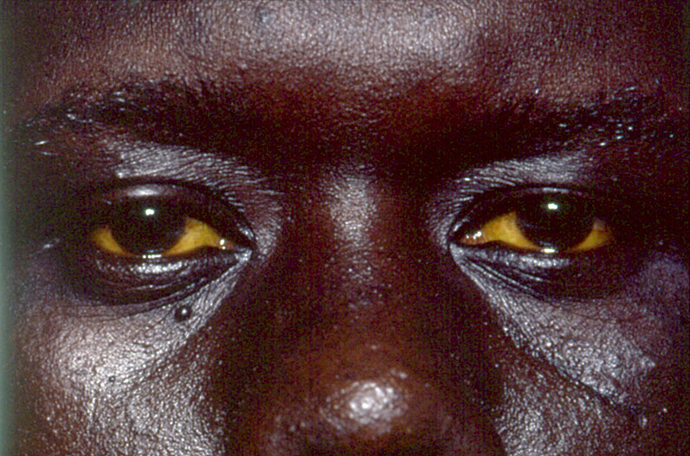
What ADR is this? What is the likely Cause?
Notes:
Jaundice – an indication of hepatotoxicity. Can result from the use of NVP

Slide 34
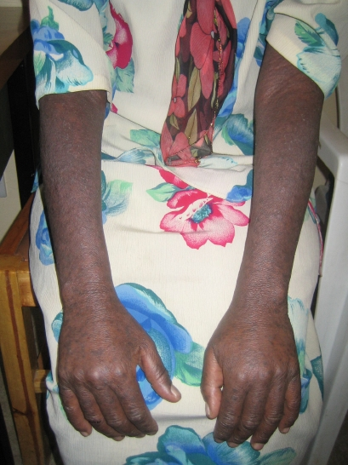
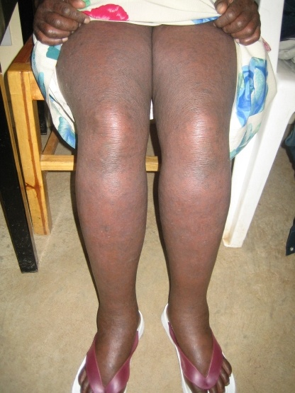
What ADR is this? What is the likely cause?
What ADR Is This? What is the Likely Cause?
MDH/MSF
Notes:
Grade 2 rash (maculopapular dry rash over > 50%) body surface. Commonly results from use of NVP

Slide 35
Rash
Most commonly due to Nevirapine.
NVP rash associated with:
  Gender (female > male; RR 4.85-8.31)
  CD4 count/disease stage
  previous sulphur allergy (RR 5)
Also reported with EFV, ABC, FPV, LPV, IDV, AZT and Cotrimoxazole

Slide 36
Abacavir Hypersensitivity
Incidence: 5-9% (Caucasians). HLA determined and predictable
Associated with:
  female gender
  higher CD4 count
Presents with fever, rash, respiratory or GI symptoms; hepatitis also occurs (multiple systems)
Symptoms worsen with each dose
Within first 2 months of treatment (median 8 days)

Slide 37
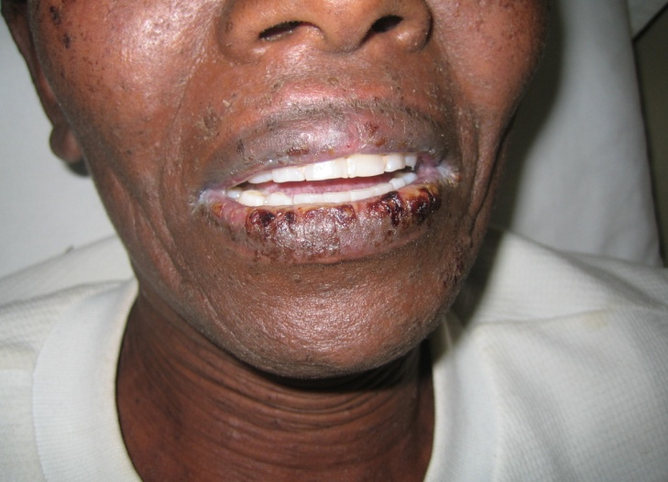
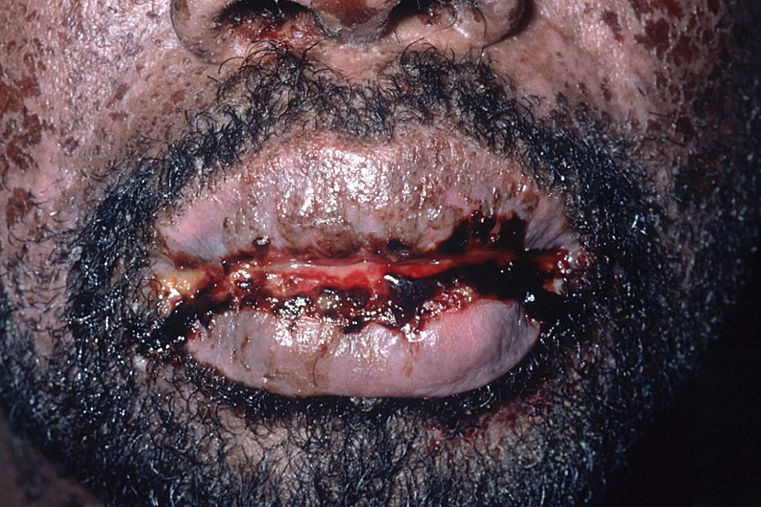

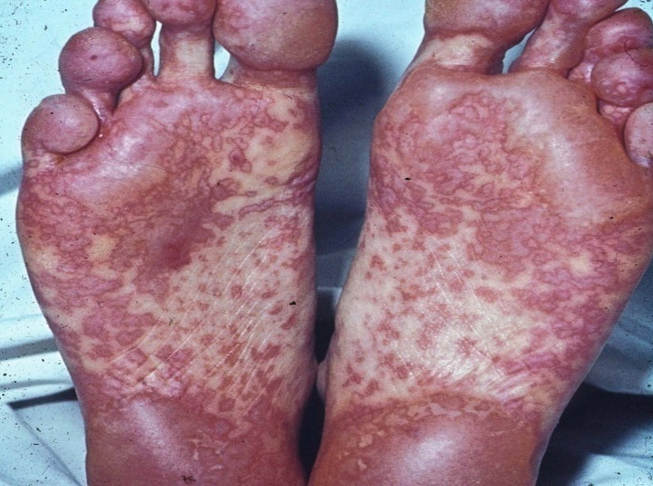
What ADR is this? What is the Likely Cause?
Notes:
Trainers Notes:
This is Stevens Johnsons Syndrome
Mainly caused by the NNRTIs and ABC

Slide 38
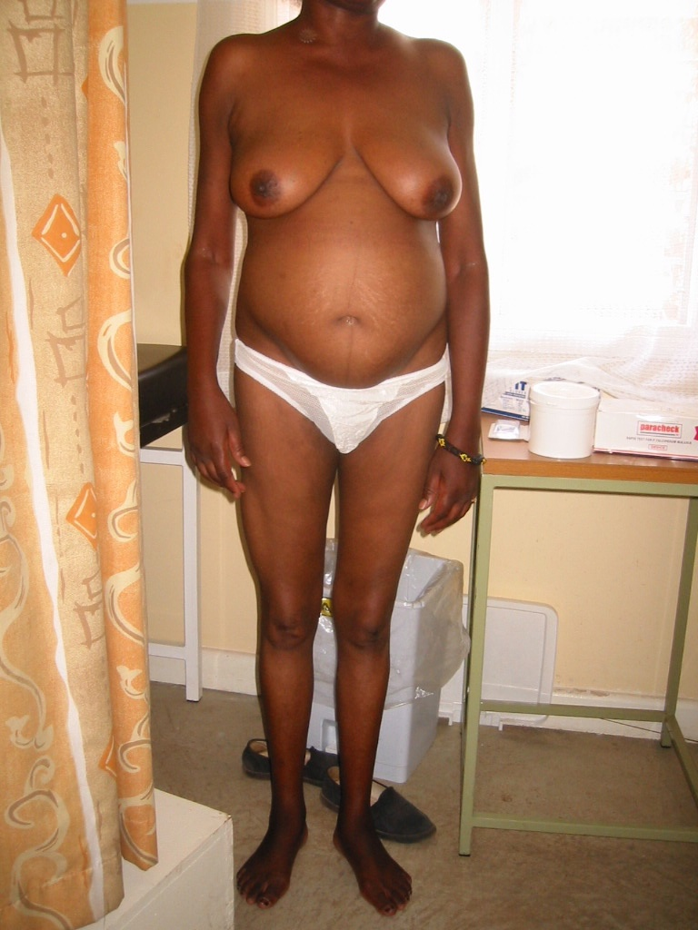
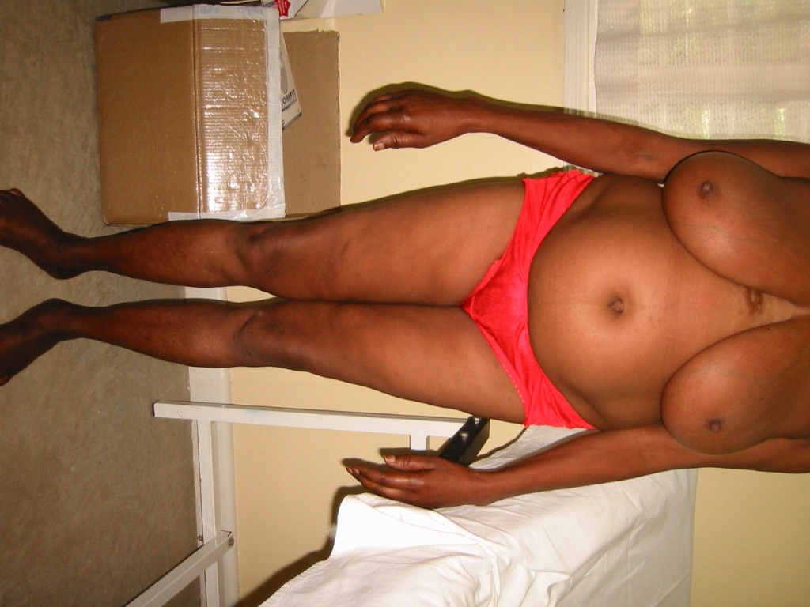
Which ADR is this?
Notes:
Trainers Notes:
Ask the participants to identify the ADR:
Lipodystrophy

Slide 39
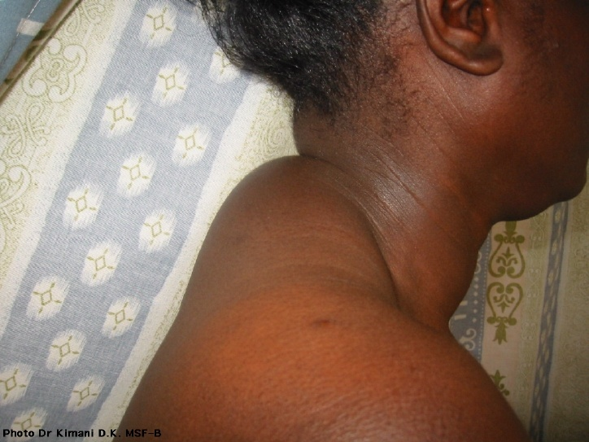
What ADR is this? What is the Likely Cause?
Notes:
Trainer Notes:
Lipodystrophy with ”buffalo hump”, (accumulation of fat over dorsocervical spine)

Slide 40
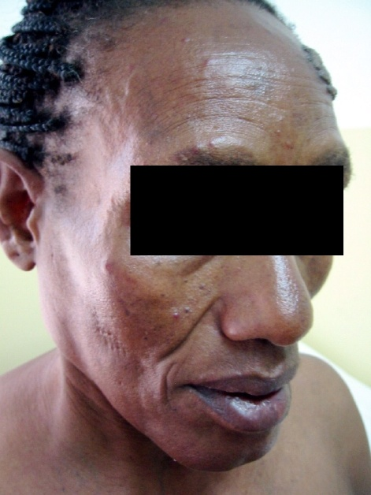
What ADR is this? What is the Likely Cause?
Notes:
Trainer Notes:
This is a Lipoatrophy due to NRTIs

Slide 41
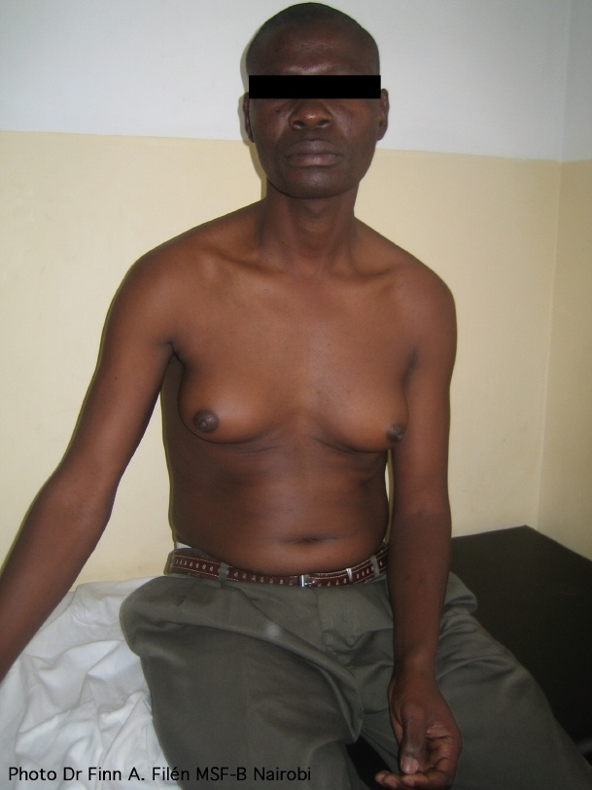
What ADR is this? What is the Likely Cause?
Notes:
Gynecomastia - In this case due to Efavirenz (not common)

Slide 43
Dolutegravir
Advantages
It is highly effective.
It is well tolerated.
It is easy to take.
It has few interactions with other medicines.
It has a high barrier to resistance
It can be more affordable

Slide 44
Dolutegravir
Side Effects
Fever
General ill feeling
Tiredness
Muscle or joint aches
Blisters or sores in your mouth
Blisters or peeling skin
Redness or swelling of your eyes
Swelling of your mouth, face, lips, or tongue
Trouble breathing
An increased risk of developing new or worsening liver problems

Slide 45
Lactic Acidosis
Usually occurs after at least 6 months of NRTI treatment
Clinically insidious onset with nausea, vomiting abdominal pain, weakness, weight loss, SOB
Respiratory failure pancreatitis, multi-organ failure
Diagnosis based on clinical presentation and confirmed where possible with a lactate test
Notes:
Trainer Notes:
Use the following slides to discuss Lactic Acidosis

Slide 46
Lactic Acidosis: Signs & Symptoms
  Non-specific:
      fatigue
      myalgia,
      nausea, vomiting,
      diarrhea, abdominal distension,
      weight loss
      Dyspnea
    Clinicians should be “suspicious” if any patient presents with these symptoms
Notes:
Trainer Notes:
Main message from this slide to state that Lactic acidosis clinical presentation is usually non-specific

Slide 47
Lactic Acidosis
  Laboratory diagnosis
    Elevated serum lactate levels (>2mM)
    Other common lab tests that may suggest this abnormality;
      elevated CPK, LDH, amylase or AST
      increased anion gap (Na – {Cl + CO2} >16);
      low serum albumin;
      liver biopsy showing hepatic steatosis
Notes:
Trainer Notes:
Main message:
Lactic acidosis laboratory findings
CPK – Creatinine Phosphokinase
LDH – Lactate Dehydrogenase
AST – Aspartate Aminotransferase

Slide 48
Hematotoxicity
Is related to bone marrow reserve, dose and duration of treatment, and stage of disease
AZT by far the most common cause
  Most likely in women, those with pre-existing anemia and low baseline CD4 count
  Peaks at 4-12 weeks after treatment initiation
  AZT can also cause neutropenia, thrombocytopenia
Diagnosis
  Symptoms: Anemia, Neutropenia
  Laboratory diagnosis: Hb
Notes:
Trainer Notes:
Main message:
Hematotoxicity: diagnosis and management

Slide 49
Hepatotoxicity (1)
Signs & Symptoms
  Symptoms: two forms of hepatoxicity seen
    Occuring in the first 6 weeks of treatment and is accompanied by fever, rash and GI symptoms and sometimes associated with hepatic necrosis- serious and is NVP associated
    Occuring later in the course of treatment, usually asymptomatic- seen with PIs, NVP and EFV.
  Laboratory diagnosis: Elevated liver transaminases
Notes:
Trainer Notes: use the next two slides to discuss hepatotoxixity.
Main message:
Most antiretroviral drugs have been implicated in hepatotoxicity.
The evaluation should include the following tests before therapy: liver enzyme tests, screening for hepatitis A,B and C, there needs to be a record of alcohol intake and illicit drug use.
Many OIs involve the liver and correlate with CD4 cell counts in terms of probabilities: CMV, MAC, hepatic peliosis (Bartonella), histoplasmosis, cryptococossis, TB, lymphoma, etc. Other potentially hepatotoxic drugs include azoles and sulfonamides.
The most serious forms of toxicity are hypersensitivity reactions to nevirapine or abacavir which usually occur within the first six weeks of treatment and are clinically expressed with abnormal liver tests combined with eosinophilia, fever, rash, GI complaints. In the absence of symptoms, hypersensitivity or hyperlactatemia, withdrawal of ART should be done only if the abnormal test exceed the upper limit of normal (ULN) by ten fold (grade 4 toxicity). It is important to exclude other causes of liver injury such as alcoholic hepatitis, acute hepatitis A, etc. Asymptomatic elevations of liver tests that are less than 10 times the ULN should be followed, but do not require drug discontinuation. Longitudinal tests suggest that these patients will reach a plateau and then their liver test will gradually return toward normal

Slide 50
Hepatotoxicity (2)
Nevirapine is most likely to cause hepatotoxicity
  12 x more likely in women than in men
  More likely at initial CD4 >250 in women and CD4>400 in men

Slide 51
Peripheral Neuropathy (1)
Signs & Symptoms
  Symptoms: pain, numbness and/or paresthesias in extremities
Associated with
  NRTI therapy
  Duration of therapy
  Lower CD4 count
  Alcohol use
Incidence: 5-10%
d4T and ddI most common cause
  Especially if used together or with other drugs likely to cause PN (e.g. Isoniazid)
Can be disabling and irreversible
Notes:
Trainer Notes:
Main message:
Pyridoxine is not useful for neuropathy due to NRTIs. It is important to stop the offending drug as neuropathy due to NRTIs is irreversible

Slide 52
Peripheral Neuropathy (2)
d4T and ddI most common cause
  Especially if used together or with other drugs likely to cause PN (e.g. Isoniazid)
Can be disabling and irreversible
Patient education and counseling on adverse drug reactions should be done
Symptomatic management if mild

Slide 53
Pancreatitis
Rare, but can be fatal
Signs & Symptoms
  Abdominal pain, vomiting, hypovolemic shock; may be asymptomatic
  serum amylase
ddI and d4T most common causes
  Especially if together or with other pancreas damaging drugs (e.g. alcohol)
Notes:
Trainer Notes:
Use this slide to discuss pancreatitis

Slide 54
Delayed Toxicities
Lipid abnormalities – all classes
Insulin resistance including frank diabetes (PIs)
Cardiovascular disease
Notes:
Trainer Notes:
This slide provides examples of delayed toxicities

Slide 55
Management of ADRs
Notes:
Trainer Notes:
Use the following slides to discuss the management of ADRs

Slide 56
Management of ADRS: Principles
Use of well tolerated regimens associated with low toxicity, as much as possible, early in treatment
Avoiding drug combinations likely to be associated with toxicity as much as possible
Remember additive/overlapping toxicities
Proactive assessment for predictable toxicity
Notes:
Trainer Notes:
This slide discusses the principles of managing ADRs

Slide 57
Managing ADRs
Try and establish the ARV drug responsible for the adverse effect
Consider duration of ARV use, other disease processes (e.g. hepatitis), other treatments (including self administered)
If it is necessary to stop ART, discontinue all ARV drugs simultaneously*
Grade 1 or 2 reactions: continue ART under observation.
  Single drug substitution may be necessary
Grade 3 or 4- Stop ART; manage Adverse Event and re-introduce
Notes:
Trainer Notes:
Sometimes its difficult to distinguish between an ADR and the disease process
NNRTI containing regimens should not be stopped abruptly. The NNRTI should be stopped 2 weeks before the NRTI backbone to avoid monotherapy of the NNRTI (Due to long half life of NNRTIs)

Slide 58
Managing ADRs
Nevirapine Induced Rash
Grade 1 or II Rash:(Erythema and pruritus < 50% of body or diffuse maculopapular rash or dry desquamation)
For new Patients may increase dose to BD if Grade I
For Grade II, If patient is recently started on NVP continue OD dosing after the first 2 weeks, review after another 2 weeks, to BD if rash has not worsened, change to EFV based regimen if rash worsens
Grade III or IV Rash: (Vesiculation or ulceration, may include mucouse membrane involvement)
Discontinue entire Regimen
Wait Until Rash improves/resolves
Change Regimen to EFV based
Notes:
Trainer Notes:
Current Guidelines for Antiretroviral Therapy in Kenya advise discontinuation of NVP for two weeks and then changing to EFV based regimen without interrupting the NRTI backbone
Trainer:
Ask participants what is the practice at home facilities in terms of managing NVP induced rash
Ask participants why NVP would be stopped first and for two weeks (Answer: long half-life of NVP)

Slide 59
Managing ADRs
Stavudine induced Peripheral Neuropathy
Grade I or II: (mild-moderate tingling or burning, minimal motor weakness, mild-moderate decrease in sensory sensation)
Continue with current dose and recheck after 2 weeks
Recheck after 2 weeks, if worsens change to Zidovudine
Grade III or IV: (severe to incapacitating pain on walking, total sensory loss, bedridden)
If patient is taking INH add pyridoxine 50mg TDS
Consider if other neurotoxic drugs e.g. INH can be stopped
Change to Zidovudine
Notes:
Trainer Notes:
Symptoms may be irreversible. It’s important to diagnose PN early and change to a suitable alternative before permanent damage occurs

Slide 60
Managing ADRS
Zidovudine induced Haematoxicity
HAEMATINICS DO NOT HELP!
Grade I or II: Hb (7-9.4)
Continue ZDV and check after 2 weeks & 4 weeks
If has not worsened continue ZDV at the same dose
Grade III or IV: (Hb <7)
Change to Stavudine based regimen
Notes:
Trainer Notes:
If Stavudine unsuitable, other options include Tenofovir and Abacavir

Slide 61
Role of Health Care Worker in Managing ADRS
Identification
Referral of patient to appropriate clinician
Dispensing drugs used to manage ADRs
Counseling patients on medications
Educating patients on ADRs (identifying & informing clinician
Documenting and Reporting ADRs
Notes:
Trainer Notes:
Trainer should ask participants what they perceive is their role in managing ADRs
Trainer should emphasis the importance of documenting ADRs even for the dispenser-Trainer should ask participants how they keep records of ADRs of patients who have experienced ADRs at pharmacy level, whether they even have them and whether they consider them important
It is important for the dispenser to document ADRs at pharmacy level because this will assist in counseling patients. This activity should not be left to clinicians alone.
In some facilities, an ADR book is kept to record this information. Some ART sites that have electronic dispensing tools are able to record this information.
Once documented ADR reports can then be generated and shared with the clinical team to guide patient care, prescribing patterns as well as management of ADRs and identification of risk factors in order to put in measures that can prevent ADRS

Slide 62
Case Study 1
A 20 yr old woman with WHO stage II AIDS started ARVs 3 wks ago. She was prescribed a triple combination tablet b.d. of Stavudine 30 mg, Lamivudine 150 mg & Nevirapine 200 mg.
10 days after starting this medicine, the woman broke out with a rash. She promptly stopped taking the ARVs and came to the clinic as soon as she was able. Today her rash is much less than it was a week ago.
What questions would you ask?
How would you manage this patient?
What advice would you offer?
Notes:
For the Trainers: Patient rash was an itchy maculopapular rash mostly on the trunk and upper extremities
Questions to ask:
How extensive is the rash?
How do the rashes look like – do they have liquid inside, are they ulcerated?
Is there any mucous membrane involvement or discolouration of skin?
Is there reddening ?
Is the patient on CTX?
Management
Grade the rash-ask participants what grade they would place the patients (Patient was graded as grade 1)
Follow the algorithm in the guidelines
What would you prescribe for the rash? Ask participants to list some drugs and doses
Advice to patient
Continue ARVs at dose of 200mg qd of NVP
Start symptomatic treatment
Counsel on how to manage the S/E e.g. use of antihistamines, emollients etc
Schedule follow up in 2 weeks but advise patient to come back if symptoms persist or worsen before then.

Slide 63
Case Study 2
ANM is a 32 year old male who comes to the clinic
complaining of dysphagia, cough, oral candidiasis and
considerable weight loss. After several tests the patient is
found to be eligible for ART and the clinical team decides to
initiate him on d4T + 3TC + NVP and CTX for prophylaxis.
2 weeks later, patient presents with SJS, diarrhea and
excessive dehydration.
Which is the likely drug causing the ADR?
How would you manage the patient
Notes:
Trainer Notes:
Cotrimoxazole as well as NVP implicated in SJS. Bear in mind SJS is fatal
Discontinue Cotrimoxazole, consider Dapsone for prophylaxis and manage the dermatological manifestations
Discontinue ART Regimen and restart 2nd line after SJS resolves. Changing to EFV may be controversial due to cross-sensitivity
Cleanse skin with antiseptics e.g. gentian violet
Give steroids and other supportive treatment

Slide 64
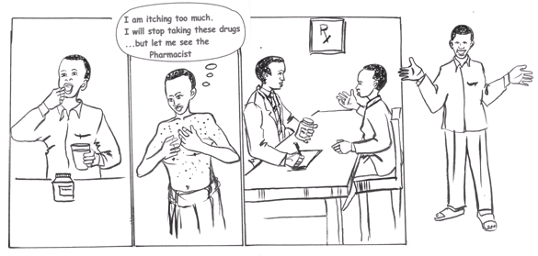
Patients Need Counseling on Side Effects
Notes:
Trainers Notes:
Patient should be aware of any S/E to expect so as not to get alarmed. Patient should know when to go back to the clinic or when and how to manage the mild S/Es at home

Slide 65
Counseling for Side Effects
Nausea-Avoid known triggers (eg, the smell of certain foods.)Antiemetics as prescribed.Teach patient to use deep breathing and relaxation at first onset of feeling nauseated. Ensure proper room ventilation.
Fatigue-It can be related to HIV itself, zidovudine-related anemia, or anemia of chronic disease, among others. Assess hemoglobin, hematocrit, liver function tests, thyroid function, or possible OIs. Treat any underlying abnormal finding.If not contraindicated, counsel patient on the use of a exercise program. Ask the patient at what time of the day the fatigue occurs and look for treatable patterns.
Shortness of breath-Can be caused by anxiety, OIs, anemia, or other respiratory conditions. Perform a comprehensive respiratory assessment. Maintain adequate fluid intake to lessen any secretions. Review proper positioning to promote ease of respiration. Avoid toxic stimulants such as smoke, perfume, and heavily scented flowers.
Difficulty in swallowing- Assess for any oral lesions or airway obstruction. Treat any pathology such as lesions or exudate. Encourage the use of soft foods. Eat foods at room temperature. Avoid "dense" foods.
Ask patient about any possible triggers (eg, food, ART, large pills, etc.)
Notes:
Trainer Notes:
Participants need to understand the importance of counseling patients regarding side effects.

Slide 66
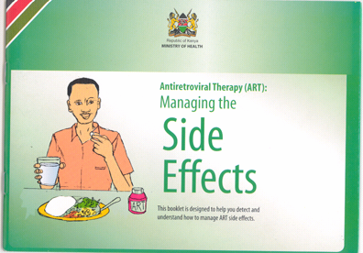
Available Materials for Counseling Patients on Side Effects
Also Available in
Kiswahili
Notes:
Trainer Notes:
Inform the participants that this is a patient information booklet that provides insight on side effects.

Slide 67

Questions??

Slide 68
Thank You

